Slide 1


Patterns for Building a Chatbot
(that doesn’t suck)
CSE
Steve Bohlen
Principal Software Engineer
& Technical Evangelist
sbohlen@gmail.com http://blog.unhandled-exceptions.com @sbohlen

Slide 2





































TITANIUM SPONSORS
Platinum Sponsors
Gold Sponsors

Slide 3
Who am I?
…and why should you care?
Steve Bohlen
I Read Books + Write Software
vs. “Read Software + Write Books” ☺
Blog, Screencast, Speak, Share, Learn

Slide 4


Steve Bohlen
Over 25 years as a software developer
LISP, Delphi, C/C++, VB, VB.NET, Java, Ruby, C#, JavaScript, node.js
Principal Software Engineer & Technical Evangelist, Microsoft
Co-Founder, NYC Alt.Net User Group
Co-Organizer, NYC DDD User Group
Contributor: various OSS projects
NHibernate
Spring.NET http://www.springframework.net
Common.Logging http://github.com/net-commons/common-logging
blog: http://blog.unhandled-exceptions.com
e-mail: sbohlen@gmail.com
twitter: @sbohlen
Membership: ASP Insiders, C# Insiders, Telerik Insiders, INETA Board of Directors
Alumni

Slide 5

I am a
employee…
…but these thoughts are my own!

Slide 6


Slide 7
The Bot Landscape
And Why You Should Care

Slide 8
What is your Chatbot Strategy?

Slide 9
What is your…
…cloud strategy?
…big data strategy?
…social media strategy?
…app strategy?
…mobile web strategy?
…SEO strategy?
…web strategy?
…SOA Strategy?
…<your meme here> strategy?

Slide 10
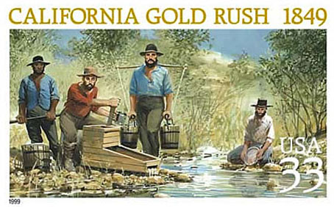

Slide 11
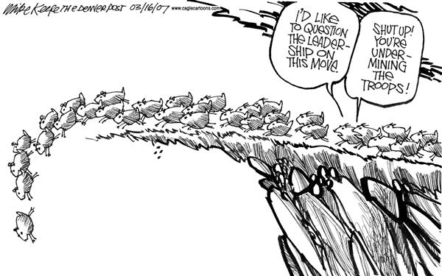

Slide 12
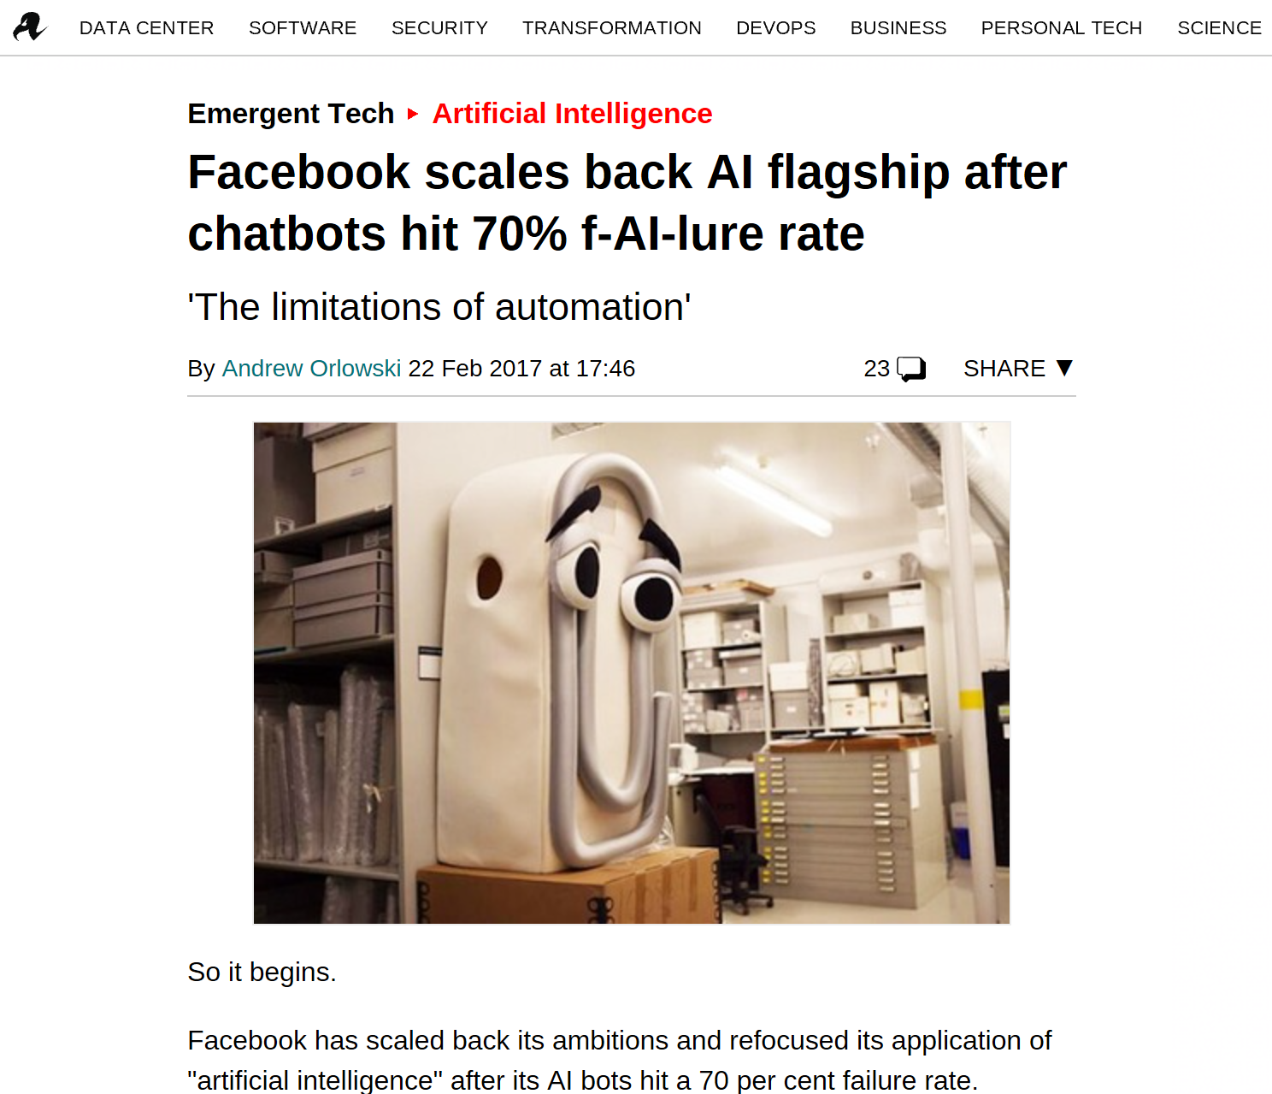

Slide 13
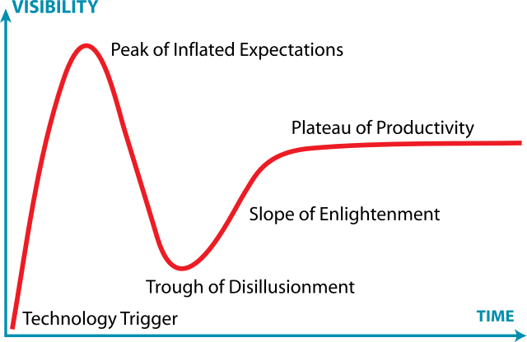

Slide 14
Bot Anti-Patterns
And Patterns Too

Slide 15
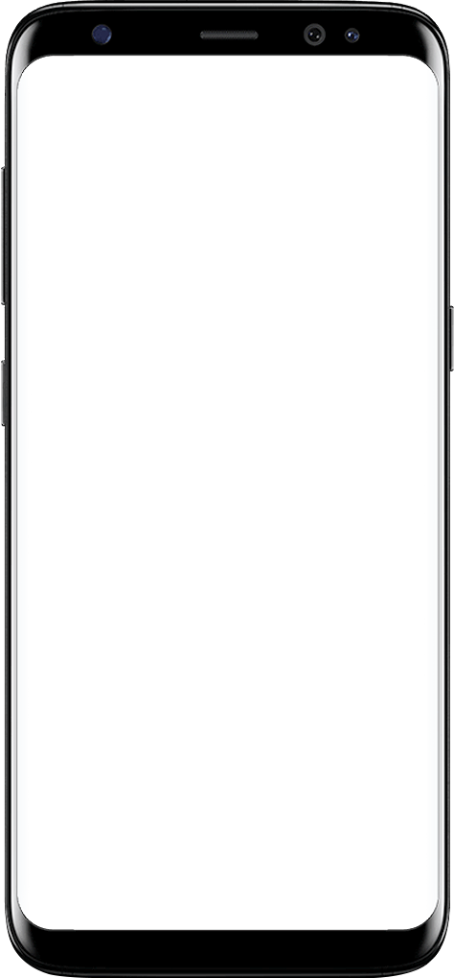
Anti-Pattern: Magic Phrases
How hot is it in New York?
I don’t know what you mean.
Pattern: Obey Postel’s Law
What’s the weather in New York?
I don’t know what you mean.
What’s the forecast in New York?
Sunny with a high of 70 degrees.

Slide 16
Anti-Pattern: Magic Words
What’s the forecast in 10010?
I don’t know what you mean.
Pattern: Do what I meant,
not what I said!
What’s the forecast in New York?
I don’t know what you mean.
What’s the forecast in New York, NY?
Sunny with a high of 70 degrees.

Slide 17
Anti-Pattern: Magic Language
¿Cuál es el tiempo en Nueva York?
I don’t know what you mean.
Pattern: U.N. Interpreter
Wie ist das Wetter in New York?
I don’t know what you mean.
Pattern: World Traveler
What’s the forecast in New York?
Sunny with a high of 70 degrees.

Slide 18
Anti-Pattern: The Sociopath
What’s the forecast in 10010?
I don’t know what you mean.
Pattern: The Empath
This bot sucks!
I don’t know what you mean.
I’ll never use this bot again!
I don’t know what you mean.

Slide 19
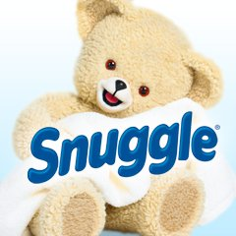
Anti-Pattern: Snuggles the Bear
Hi! I’m the Weather Bot and I’m amazingly glad to be able to help make your day brighter!
Pattern: Situational Awareness
What is the forecast for New York?
Its going to be 76 wonderful degrees in the Big Apple today! What a great day for a picnic in Central Park!
I think I want to puke now.

Slide 20
Anti-Pattern: Robotic Response
How hot is it in New York?
Sunny with a high of 70 degrees.
Pattern: Variety is the Spice of Life
What’s the weather in New York?
Sunny with a high of 70 degrees.
What’s the forecast in New York?
Sunny with a high of 70 degrees.

Slide 21
Anti-Pattern: Spelling-Bee
What’s the waether in New York?
I don’t know what you mean.
Pattern: F7
What’s the weather in New yrk?
I don’t know what you mean.
What’s the weather in New York?
Sunny with a high of 70 degrees.

Slide 22
Anti-Pattern: You ain’t from ‘round here, are you?
How hot is it in New York?
Cold enough to bring the chickens in from the coop tonight!
Uh…WTF does that mean?
Pattern: Know Your Audience

Slide 23
Anti-Pattern: WWW, circa 1995
What’s the weather in New York?
Sunny with a high of 70 degrees.
Pattern: Session State
What about tomorrow?
I don’t know what you mean.
How about San Francisco?
I don’t know what you mean.

Slide 24
Anti-Pattern: Location Ignorance
Good morning! Welcome to the Weather Bot!
Pattern: Assuming makes an ass out of u and me
Uh…its 9pm here, stupid!
What’s the weather in New York?
Sunny with a high of 70 degrees.
Uh…is that Farenheit or Celsius?

Slide 25
Anti-Pattern: para el español, presione dos
What’s the weather in New York?
Enter “1” for high temperature. Enter “2” for low temperature. Enter “3” for precipitation. Enter “4” for wind-speed.
Pattern: Just don’t. Please.
How about I enter “9” for “worst bot ever”?

Slide 26
Anti-Pattern: Mobile Web Experience
What time is it?
10:00 AM
Pattern: Stay true to the medium.
Couldn’t you have just *said* that???

Slide 27
Anti-Pattern: Nigerian Prince
Hey, its sunny with a high of 70 degrees.
I noticed it just got 5 degrees cooler.
Pattern: Respect User Preferences
The wind just picked up!
Its going to rain tomorrow – don’t forget your umbrella!
Hurricane Donald is approaching Washington, D.C!

Slide 28
Anti-Pattern: Monologue
What’s the weather in New York?
Today in New York it is sunny with a high of 70 degrees. Winds are variable from the east at 20 mile per hour. There is a moderate chance of precipitation in the form of rain expected sometime in the mid-afternoon between the hours of 2:30pm and 4:30pm. The sun will rise today at 6:42am. The sun will set today at 7:12pm. The barometer is rising at 113 millibars. There is a small-craft advisory in effect for f
Pattern:
Dialog

Slide 29
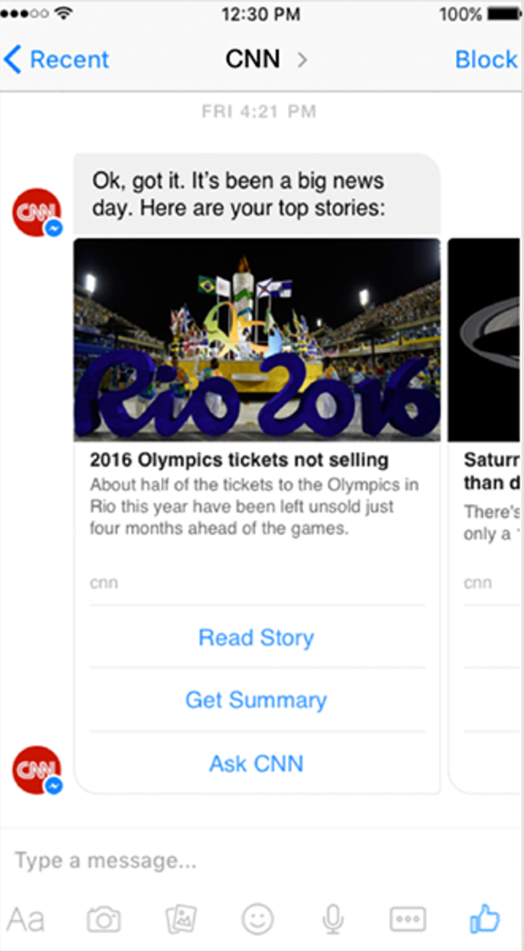
Anti-Pattern: Pointless
Pattern:
Raison D’être

Slide 30
Anti-Pattern: What else have you seen?
????

Slide 31
Demo: Exploring a Bot
(that hopefully doesn’t suck too much!)

Slide 32
Input Processing Pipeline
Log Input
Spell-check
Calculate Sentiment and Respond
Resolve Synonyms
Track interaction history and Respond
Detect Language
‘Raw’ input
Detect Slash
Intercept commands and abort processing pipeline if detected
Run on ‘raw’ input for highest accuracy
Needed as input to downstream steps
Correct for inexact user input
Track user emotion over time
Abort processing if too negative
Simplify NLP model training by reducing the scope of entity recognition
Respond intelligently to user behavior over time

Slide 33
Code: Exploring a Bot
(in moderate detail)

